Slide 1
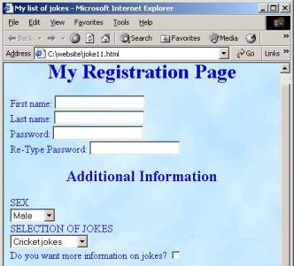



HTML Forms and Frames
Doncho Minkov
Technical Trainer
http://minkov.it
Telerik Web Design Course
html5course.telerik.com

Slide 2


Table of Contents
HTML Forms
Form Fields and Fieldsets
Text Boxes
Buttons
Checkboxes and Radio Buttons
Select Fields
Hidden Fields
Sliders and Spinboxes
Validation Fields

Slide 3


Table of Contents
HTML Frames
Frame and noframe tags
iframe tag

Slide 4
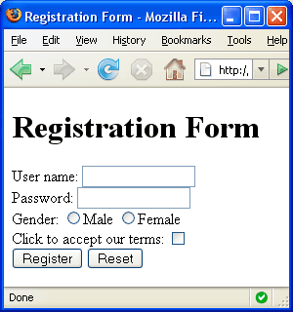


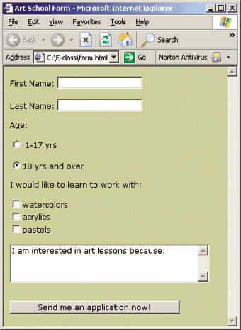
HTML Forms
Entering User Data from a Web Page

Slide 5

What are HTML Forms?
The primary method for gathering data from site visitors
HTML Forms can contain
Text fields for the user to type
Buttons for interactions like "Register", "Login", "Search"
Menus, Sliders, etc…
Check Google, Yahoo, Facebook
Google search field is a simple Text field

Slide 6
How to Create a HTML Form?
Create a form block with
Example:
The "method" attribute tells how the form data should be sent – via GET or POST request
<form></form>
<form name="myForm" method="post" action="path/to/some-script.php">
...
</form>
The "action" attribute tells where the form data should be sent

Slide 7

Text Fields
Single-line text input fields:
Multi-line text input fields (textarea):
Password input – a text field which masks the entered text with * signs
<input type="text" name="FirstName" value="This is a text field" />
<textarea name="Comments">This is a multi-line text field</textarea>
<input type="password" name="pass" />

Slide 8
Buttons
Reset button – brings the form to its initial state
Submit button:
Image button – acts like submit but image is displayed and click coordinates are sent
Ordinary button – no default action, used with JS
<input type="reset" name="resetBtn"
value="Reset the form" />
<input type="submit" value="Apply Now" />
<input type="image" src="submit.gif"
name="submitBtn" alt="Submit" />
<input type="button" value="click me" />

Slide 9
Checkboxes and Radio Buttons
Checkboxes:
Radio buttons:
Radio buttons can be grouped, allowing only one to be selected from a group:
<input type="checkbox" name="fruit" value="apple" />
<input type="radio" name="title" value="Mr." />
<input type="radio" name="city" value="Lom" />
<input type="radio" name="city" value="Ruse" />

Slide 10


Select Fields
Dropdown menus:
Multiple-choice menus
<select name="gender">
<option value="Value 1"
selected="selected">Male</option>
<option value="Value 2">Female</option>
<option value="Value 3">Other</option>
</select>
<select name="products" multiple="multiple">
<option value="Value 1"
selected="selected">keyboard</option>
<option value="Value 2">mouse</option>
</select>

Slide 11
Hidden Fields
Hidden fields contain invisible data
Not shown to the user
Used by JavaScript and server-side code
ViewState, SessionState in ASP.NET
<input type="hidden" name="Account"
value="This is a hidden text field" />

Slide 12
Labels
Labels are used to associate an explanatory text to a form field using the field's ID
Clicking on a label focuses its associated field
Checkboxes are toggled
Radio buttons are checked
Labels are
Both a usability and accessibility feature
Required in to pass accessibility validation
<label for="fn">First Name</label>
<input type="text" id="fn" />

Slide 13
Fieldsets
Fieldsets are used to enclose a group of related form fields:
The <legend> is the fieldset's title
<form method="post" action="form.aspx">
<fieldset>
<legend>Client Details</legend>
<input type="text" id="Name" />
<input type="text" id="Phone" />
</fieldset>
<fieldset>
<legend>Order Details</legend>
<input type="text" id="Quantity" />
<textarea cols="40" rows="10" id="Remarks"></textarea>
</fieldset>
</form>

Slide 14





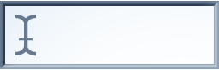
HTML Forms Inputs Fields
Live Demo

Slide 15


Sliders and Spinboxes
Lets Make It Spin

Slide 16
Range and Spinbox
Restricts users to enter only numbers
Additional attributes min, max and step and value
Can become Spinbox or Slider, depending on the input type
Have some differences on different browsers
Sliders and Spinboxes do not work on Firefox
Shown as regular textboxes
<input type="range" min="0" max="100" />
<input type="number" min="0" max="100" />

Slide 17



Sliders and Spinboxes
Live Demo

Slide 18
Field Attributes from HTML 5
Autocomplete
The browser stores the previously typed values
Brings them back on a later visit
Autofocus
The field becomes on focus on page load
Required
The field is required to be filled/selected
<input type="text" name="firstName"
autofocus="autofocus" />

Slide 19
Input Fields with Validation
Email – provides a simple validation for email
Can be passed a pattern for validation
In a mobile device brings the email keyboard
URL – has validation for url
In a mobile device brings the url keyboard
Telephone
Brings the numeric keyboard
<input type="email" required="true" pattern="[^ @]*@[^ @].[^ @]"/>
<input type="url" required="true" />
<input type="tel" required="true" />

Slide 20


HTML Forms Validation
Live Demo

Slide 21
Tab Index
The tabindex HTML attribute controls the order in which form fields and hyperlinks are focused when repeatedly pressing the TAB key
tabindex="0" (zero) – "natural" order
If X < Y, then elements with tabindex="X" are iterated before elements with tabindex="Y"
Elements with negative tabindex are skipped, however, this is not defined in the standard
<input type="text" name="second" tabindex="10" />
<input type="text" name="first" tabindex="5" />

Slide 22


Tab Index
Live Demo

Slide 23
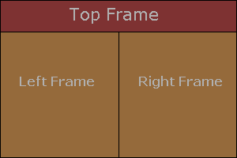
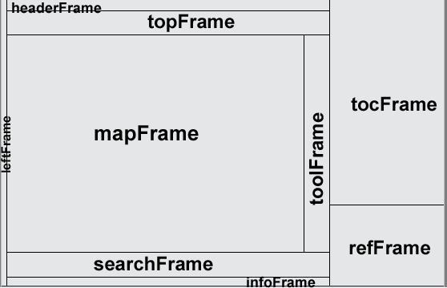
HTML Frames
<frameset>, <frame> and <iframe>

Slide 24
HTML Frames
Frames provide a way to show multiple HTML documents in a single Web page
The page can be split into separate views (frames) horizontally and vertically
Frames were popular in the early ages of HTML development, but now their usage is rejected
Frames are not supported by all user agents (browsers, search engines, etc.)
A <noframes> element is used to provide content for non-compatible agents.

Slide 25
HTML Frames – Demo
frames.html
<html>
<head><title>Frames Example</title></head>
<frameset cols="180px,*,150px">
<frame src="left.html" />
<frame src="middle.html" />
<frame src="right.html" />
</frameset>
</html>
Note the target attribute applied to the <a> elements in the left frame.

Slide 26
Inline Frames: <iframe>
Inline frames provide a way to show one website inside another website:
iframe-demo.html
<iframe name="iframeGoogle" width="600" height="400" src="http://www.google.com" frameborder="yes" scrolling="yes"></iframe>

Slide 27
HTML Forms and Frames
http://academy.telerik.com

Slide 28
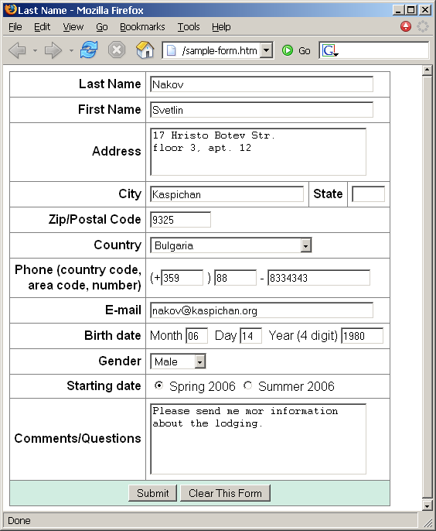
Homework (2)
Create a Web form that looks like this sample:

Slide 29
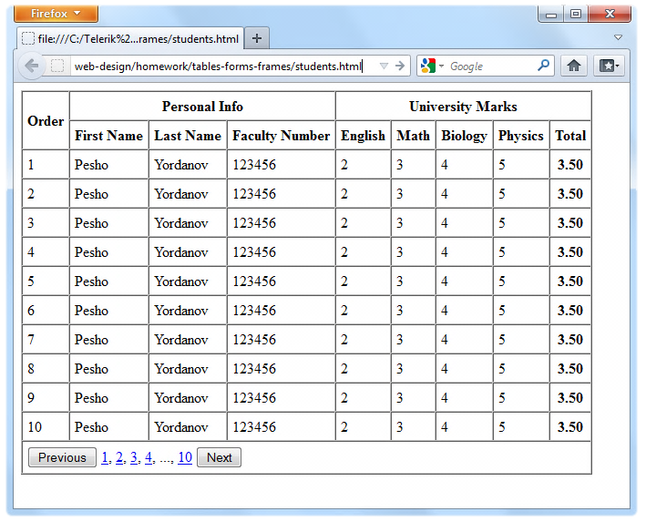
Homework (4)
Create the following using tables and forms:

Slide 30
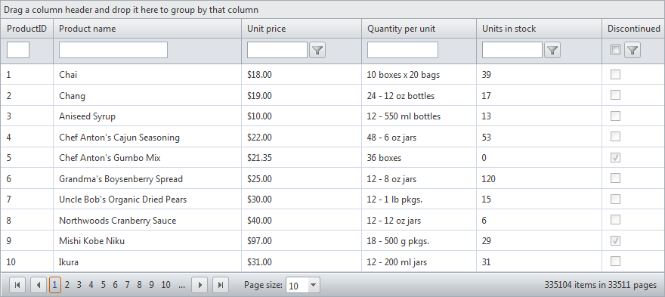
Homework (5)
Construct the following Grid component:
Try to make a HTML page, that looks just like the example
Not required to style for the homework

Slide 31
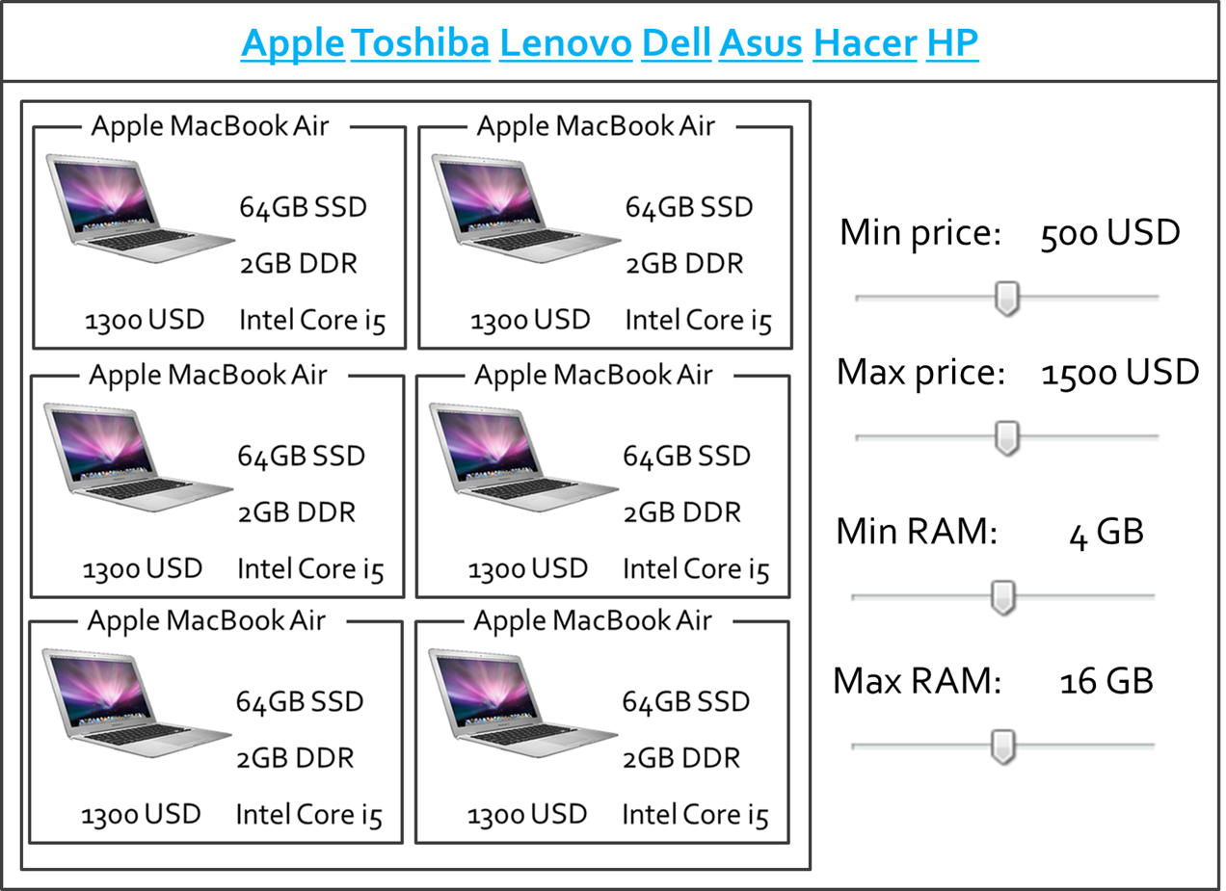
Homework (7)
*Create the following HTML Page
Hint: Use Fieldsets and Nested tables

